Slide 1
A Random Walk Through
Gambler’s Ruin
By: Jesus Tena and Jackson Jurgaitis
Advisor: Shahar Boneh

Slide 2

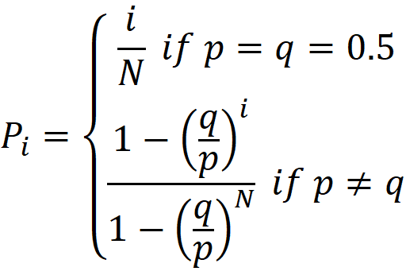
The Gambler’s Ruin Problem
The Gambler’s Ruin Problem is a famous scenario regarding gambling
A gambler walks into a casino with i dollars, hoping to reach the goal amount of N dollars. He bets one dollar on each game, with probability p of winning each game. In this problem, it is assumed that N>i. For our case, we will only change the parameters p and i, and the monetary goal N will be $10.
The probability P of the gambler reaching the goal N dollars before running out of money can be modeled with the following probability function:
p = Probability of winning 1 game
q = Probability of losing 1 game
P_{i} = Probability of reaching N before reaching 0 dollars(starting with i dollars)
N = Monetary goal
i = Initial amount

Slide 3
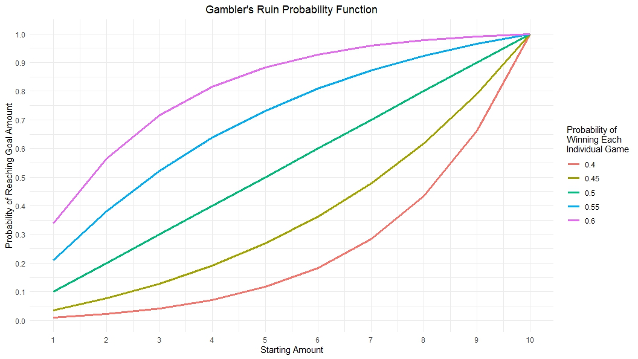
Graphing the Gambler’s Ruin Probability Function

Slide 4
The Monte Carlo Simulations
The Monte Carlo Simulations is a way to model and analyze different gambling outcomes.
Used Google Colab/Python to create a program to run simulations
We use it to simulate trials and compare them to the theoretical results.
It helps us look at only at specific variables, and will get rid of any confounding variables such as:
Time per game played
House Advantage
For our Gambler’s Ruin Problem we only changed three parameters:
i = initial amount - $3, $5, and $7
p = probability of winning 1 game - 40%, 45%, 50%, 55%, and 60%
N = monetary goal - $10 for all trials

Slide 5
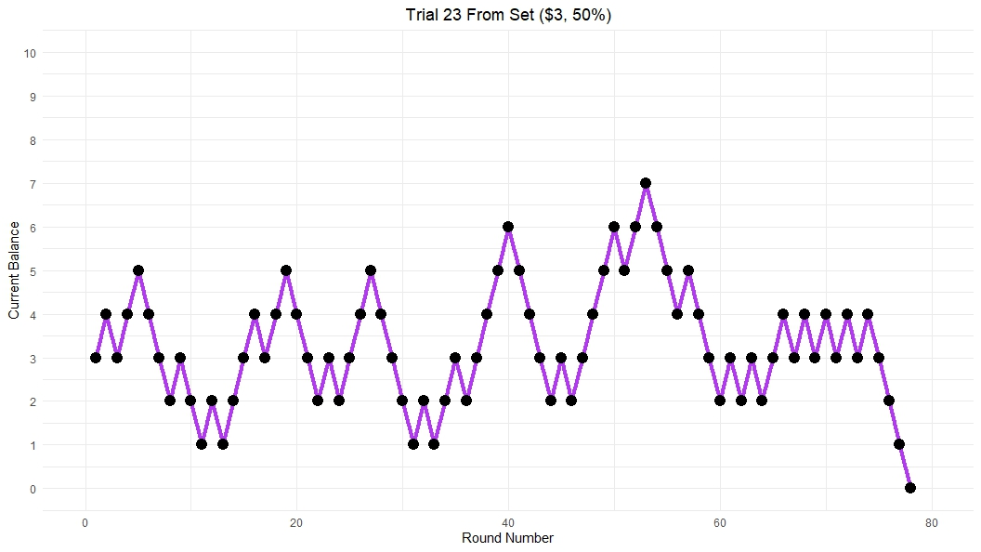
GRP Trial Graphs

Slide 6
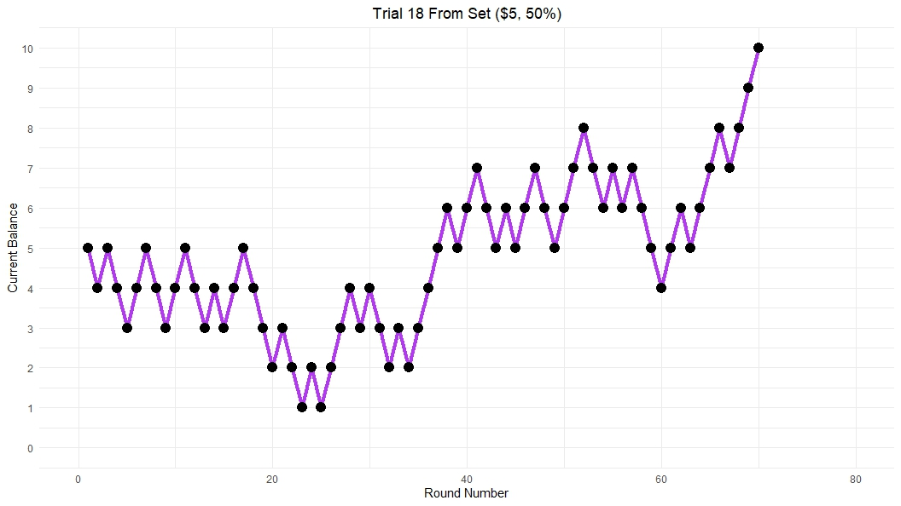

Slide 7
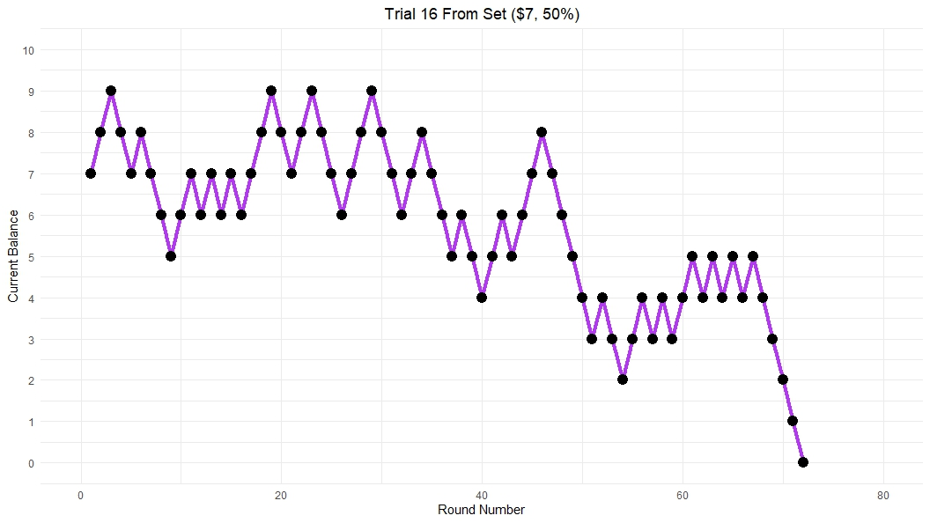

Slide 8
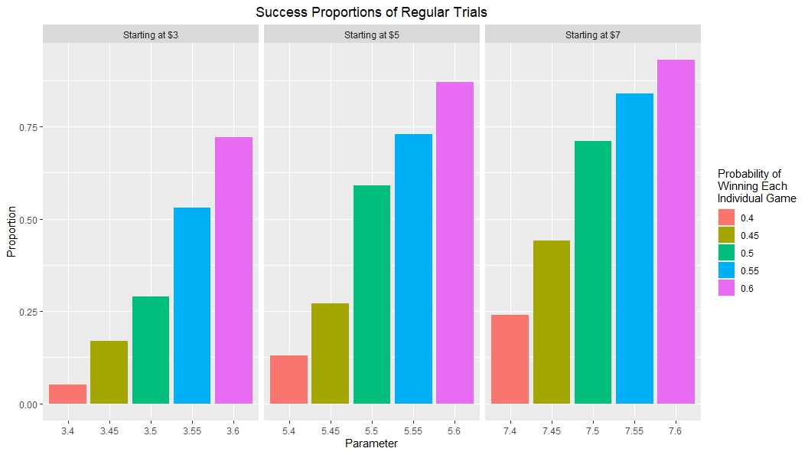
Simulated Trial Success Proportion Graph

Slide 9
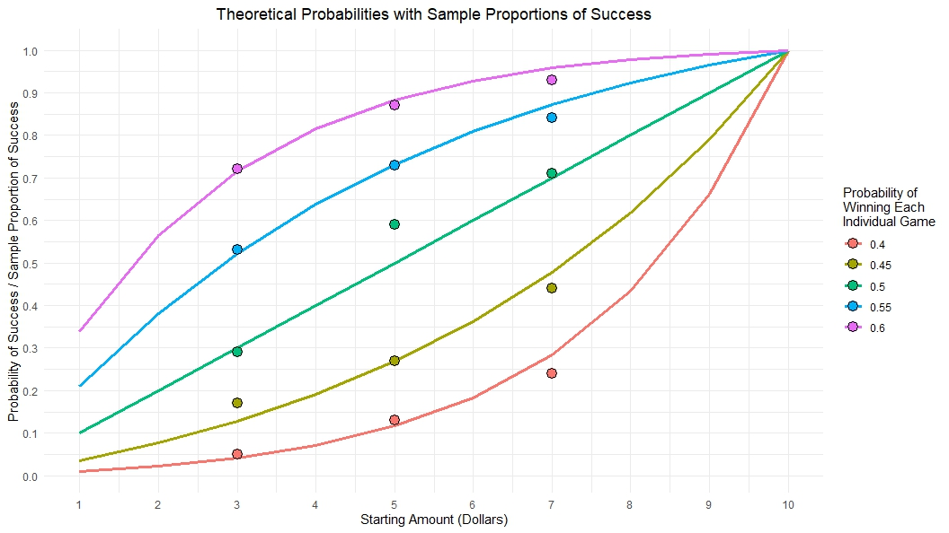
Simulated Proportions VS Theoretical Function

Slide 10
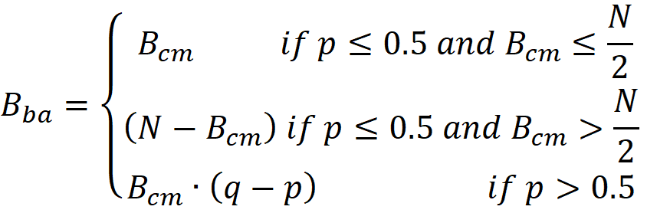

Kelly Criterion - (The Intrepid Method or Bold Play)
The Kelly Criterion (AKA ‘Bold Play’ or ‘The Intrepid Method’) is a gambling strategy in which, depending on probability, the gambler will either bet their whole balance or just a percentage of it
If the probability of winning is at/less than 50% AND they have half/less than half of the money they need to reach their target then they will bet all their money (Go All In)
If the probability of winning is at/less than 50% AND have more than half their goal, the gambler will only bet the necessary amount to reach their goal
As well as if the probability of winning is above 50% then they only bet the difference in probabilities of winning and losing as a percentage of their total balance, for EACH game
This percentage will change each game depending on either a win or a lose
B_{ba}= Bet Amount
B_{cm} = Current Money
i = ($3, $5, $7)
p = probability of winning 1 game
p = (.4, .45, .5, .55, .6)
q = probability of losing 1 game
N = Monetary Goal
N =($10)

Slide 11
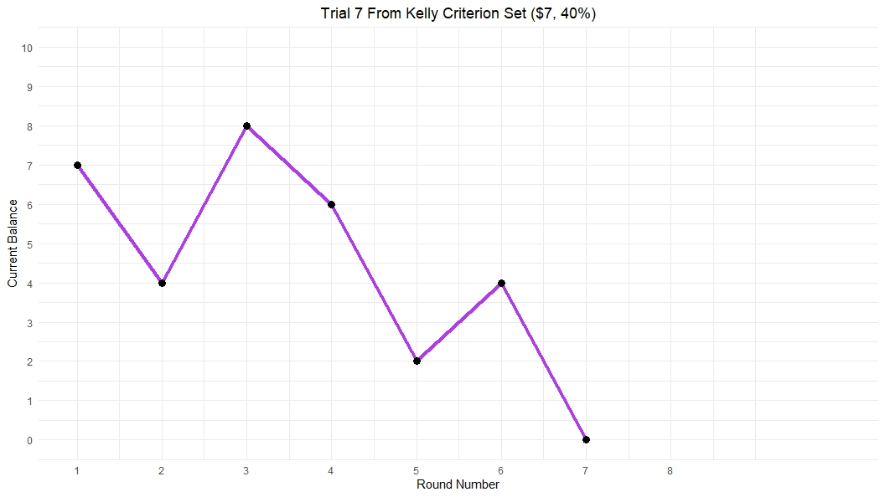

Slide 12
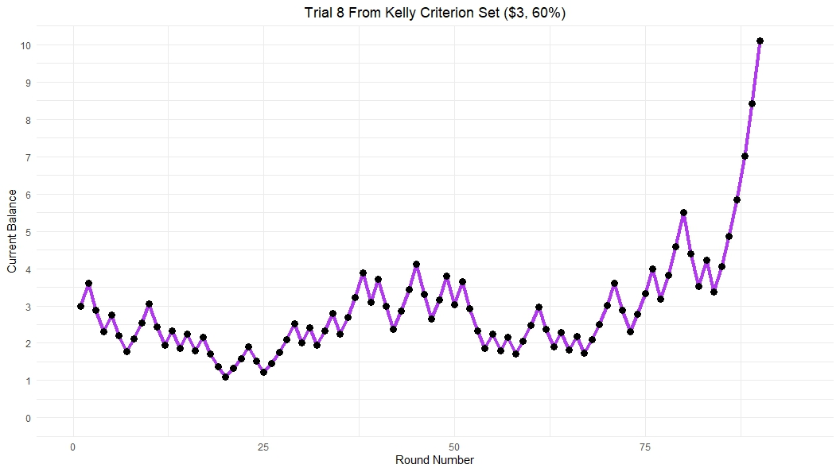
Kelly Criterion Simulated Trial Graphs

Slide 13
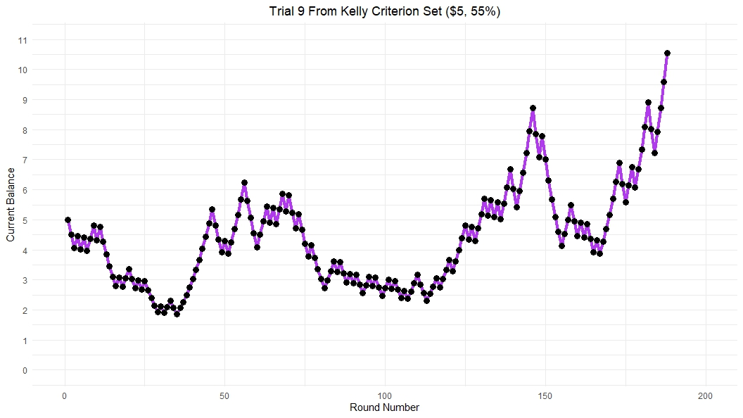

Slide 14
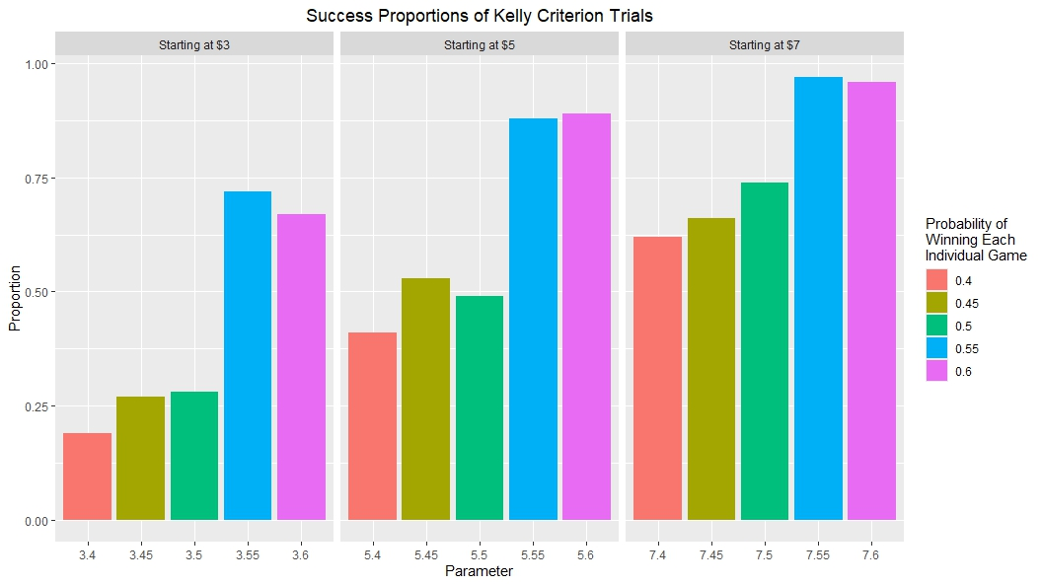
Kelly Criterion Simulated Proportion Graph

Slide 15
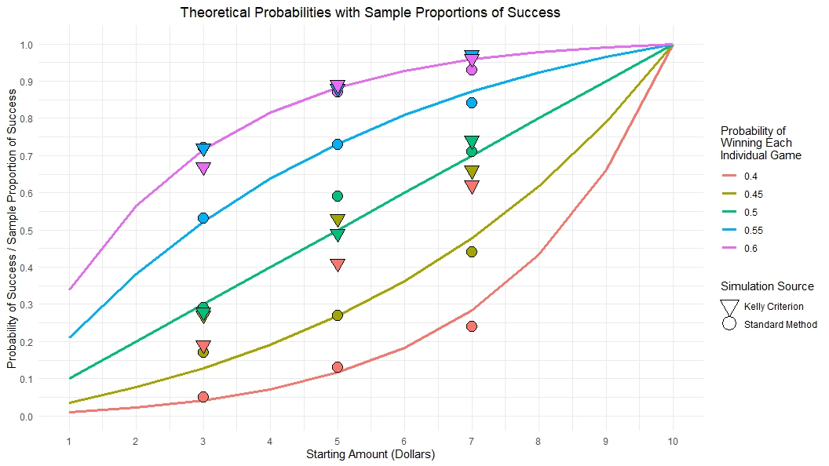
Full graph of all simulated proportions and theoretical functions

Slide 16
Acknowledgements
First and foremost, we’d like to thank our advisor, Shahar Boneh. For introducing us to the Gambler’s Ruin Problem in class, for all the valuable feedback and suggestions in making this presentation, and most importantly, for teaching us about stochastic processes so we could make this project happen to begin with.
We’d also like to thank our classmates Carl Perry and Colin Burkhart, for their insightful suggestions and feedback on our project.
I’d personally like to thank my wonderful girlfriend, Emmi Reyna, for helping me think of graph ideas and providing much needed support through the process of making this presentation. Thank you, everyone!

